Slide 1
Git Tutorials for Beginners
January 2017
FGA.BU22 – KhuVV (Public)
12e-BM/KD/HDCV/FSOFT v1/1

Slide 2
Content
What’s Git?
The simple guide
Free talk
12e-BM/KD/HDCV/FSOFT v1/1

Slide 3
What’s Git?
A version control system (VCS) which developed by Linux Development Community (lead by Linus Torvalds – the creator of Linux)
The goal of Git:
  Speed
  Simple design
  Strong support for non-linear development (thousands of parallel branches)
  Fully distributed
  Able to handle large projects like the Linux kernel efficiently (speed and data size)aaaaa
  Easy to use???
Learn more: https://git-scm.com/
12e-BM/KD/HDCV/FSOFT v1/1

Slide 4

Companies & Projects Using Git
12e-BM/KD/HDCV/FSOFT v1/1
Notes:
https://code.qt.io/cgit/
https://github.com/google
https://github.com/facebook
https://android-review.googlesource.com/#/q/status:open,n,z
https://git.kernel.org/cgit/linux/kernel/git/torvalds/linux.git
https://git.gnome.org/browse/
https://github.com/Netflix
https://git.eclipse.org/c/

Slide 5

The simple guide (1)
12e-BM/KD/HDCV/FSOFT v1/1
Notes:
Download git for OSX
Download git for Windows
Download git for Linux

Slide 6

The simple guide (2)
12e-BM/KD/HDCV/FSOFT v1/1

Slide 7

The simple guide (3)
12e-BM/KD/HDCV/FSOFT v1/1

Slide 8
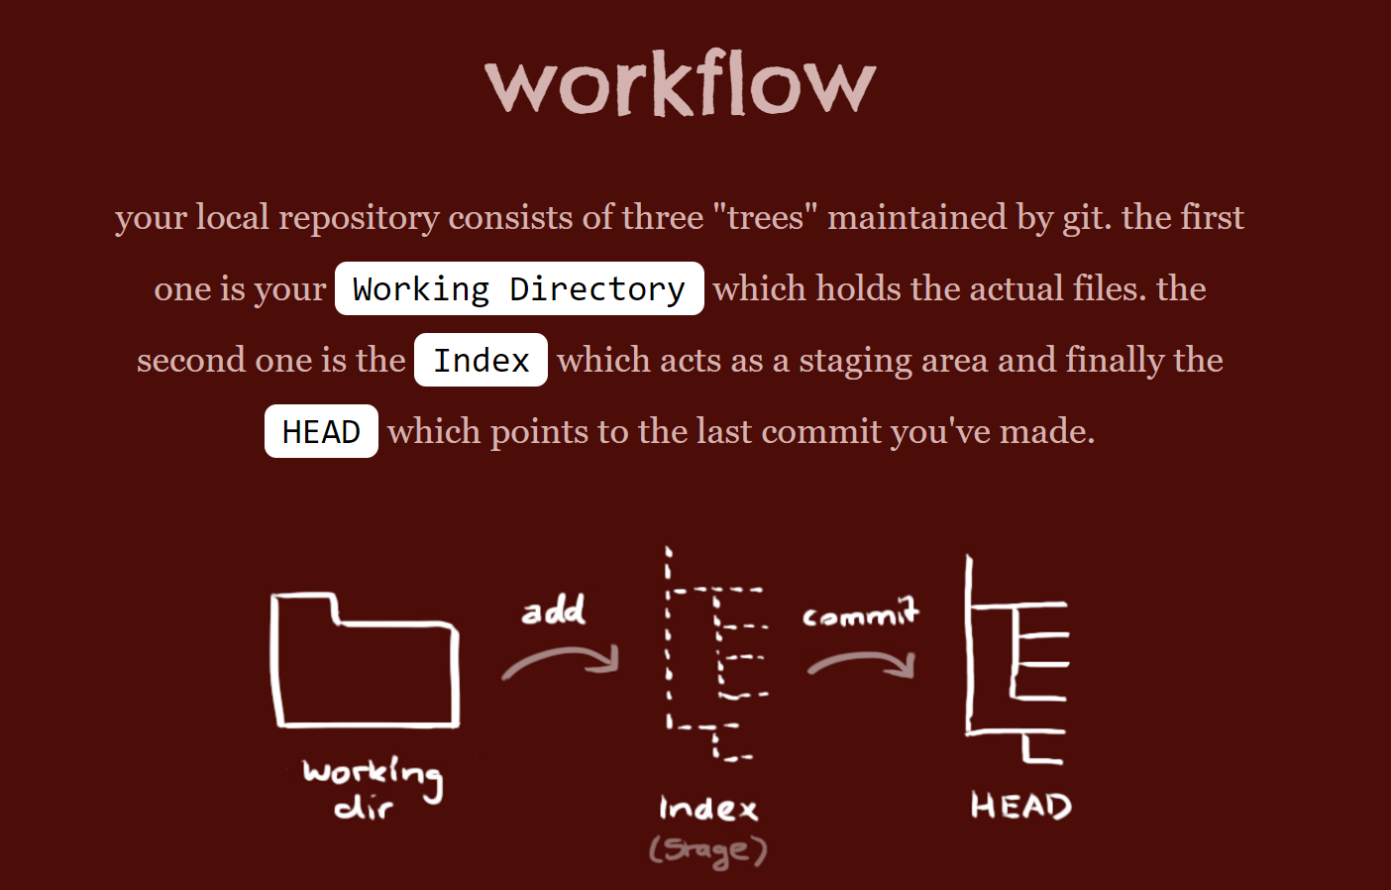
The simple guide (4)
12e-BM/KD/HDCV/FSOFT v1/1

Slide 9
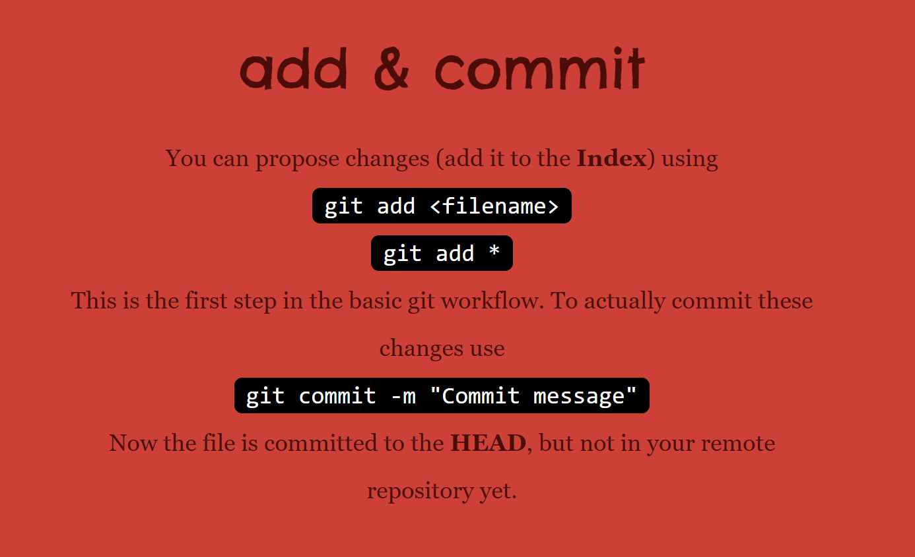
The simple guide (5)
12e-BM/KD/HDCV/FSOFT v1/1

Slide 10
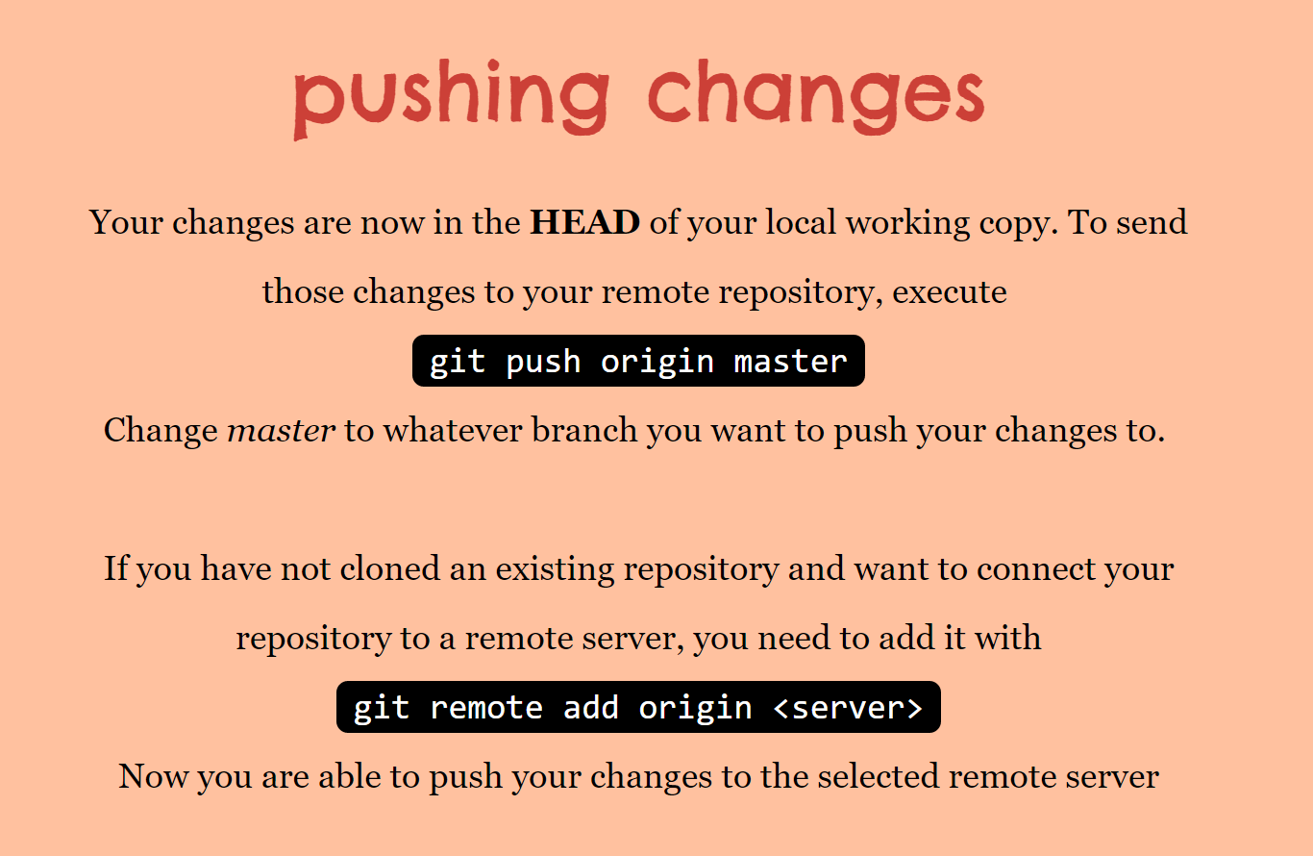
The simple guide (6)
12e-BM/KD/HDCV/FSOFT v1/1

Slide 11
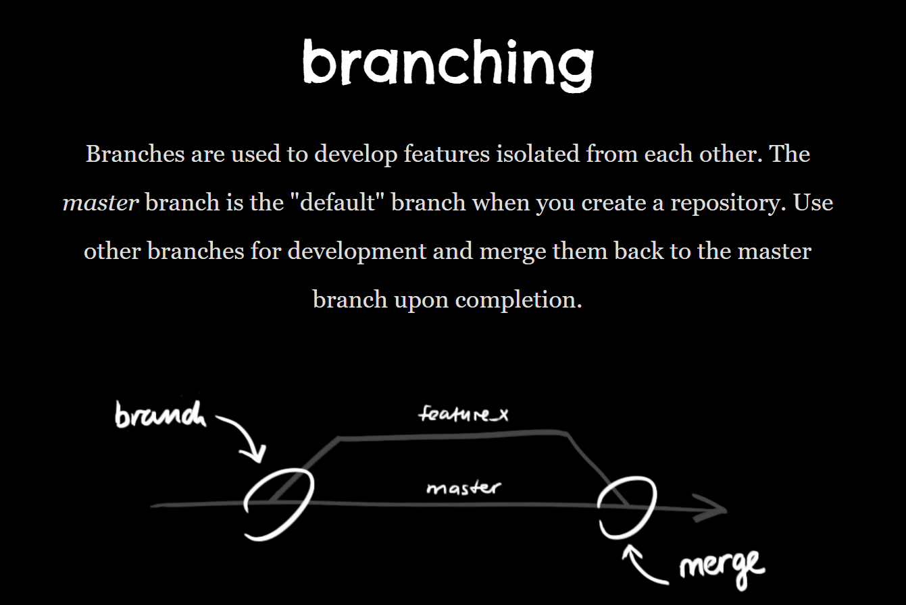
The simple guide (7)
12e-BM/KD/HDCV/FSOFT v1/1

Slide 12
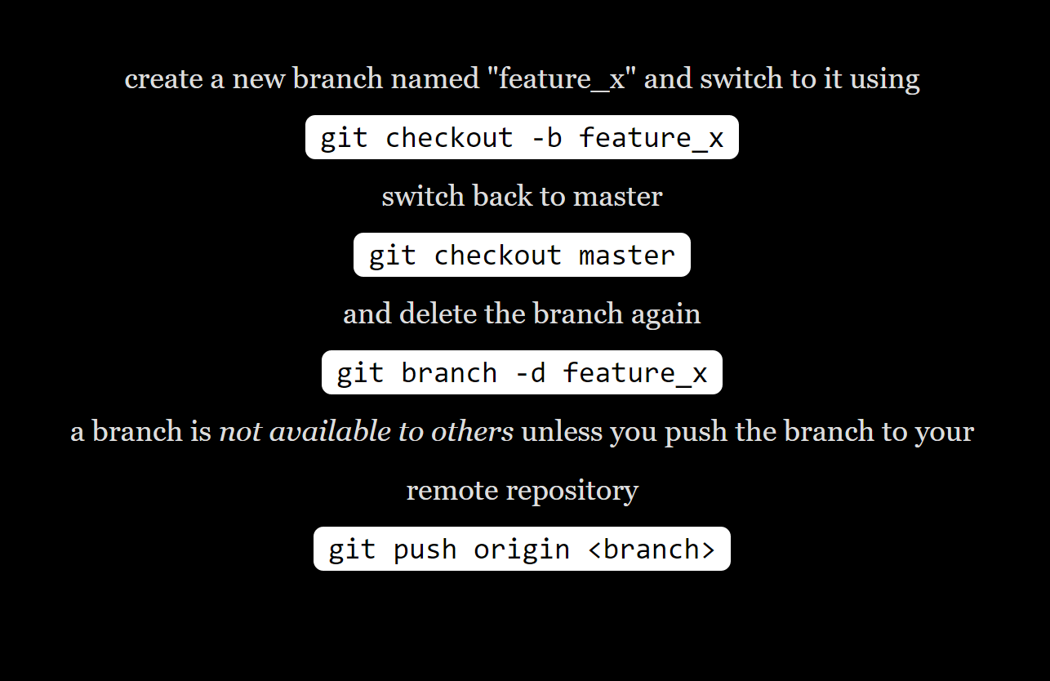
The simple guide (8)
12e-BM/KD/HDCV/FSOFT v1/1

Slide 13
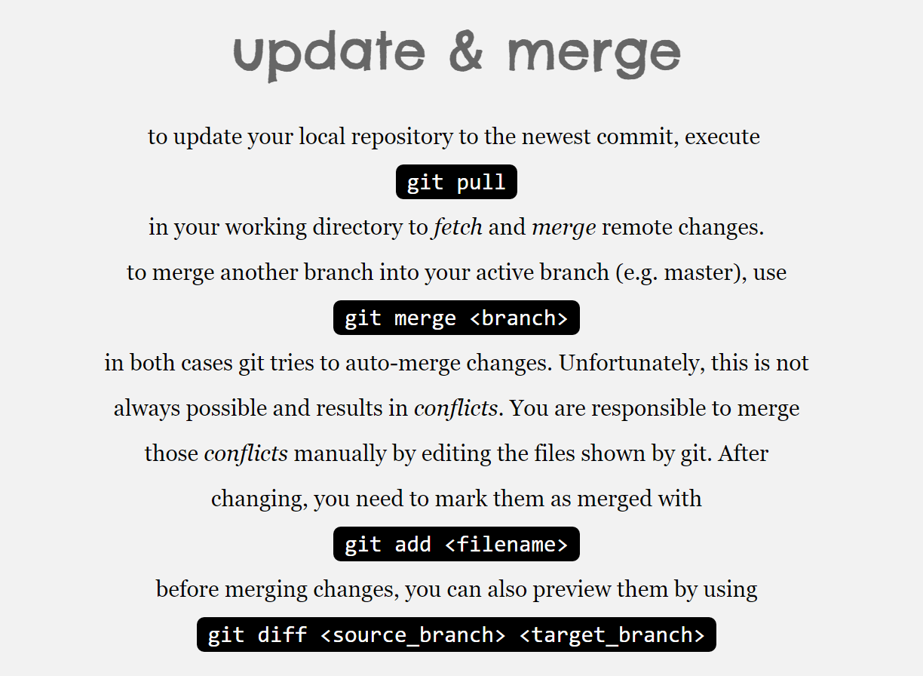
The simple guide (9)
12e-BM/KD/HDCV/FSOFT v1/1

Slide 14
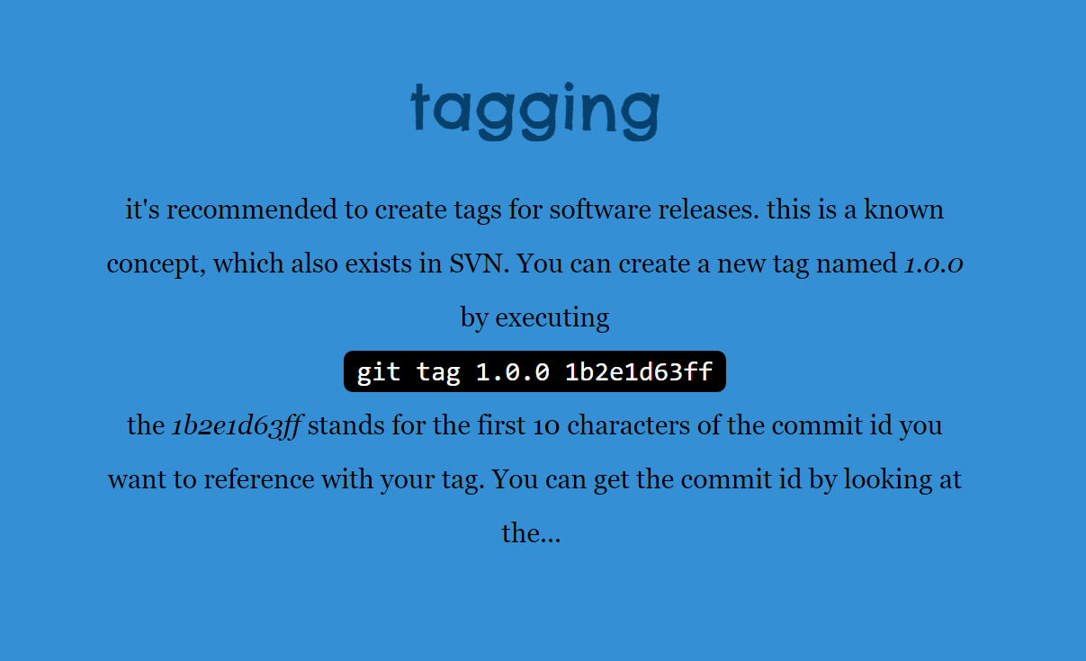
The simple guide (10)
12e-BM/KD/HDCV/FSOFT v1/1

Slide 15
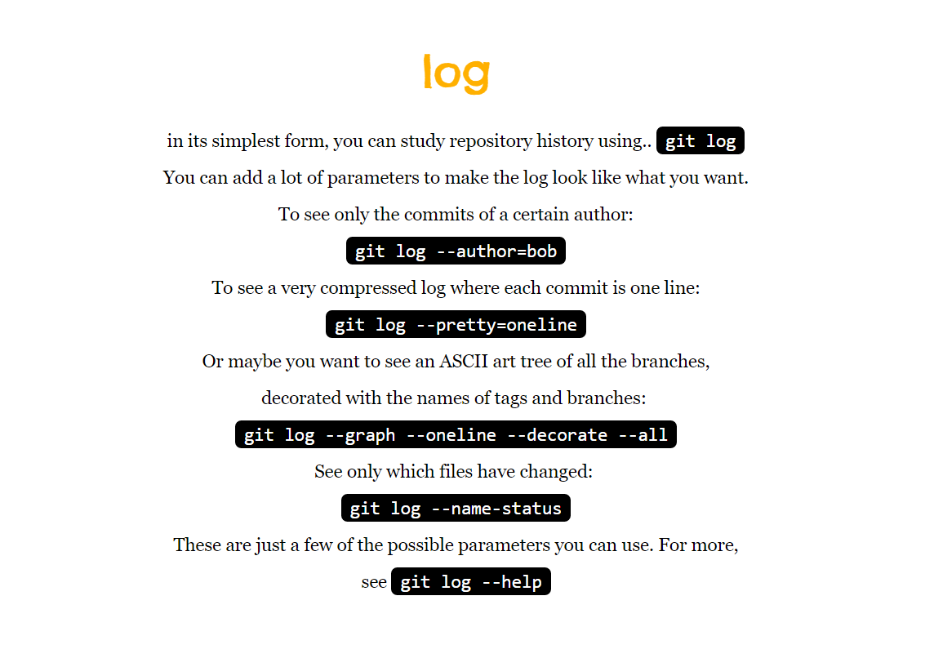
The simple guide (11)
12e-BM/KD/HDCV/FSOFT v1/1

Slide 16
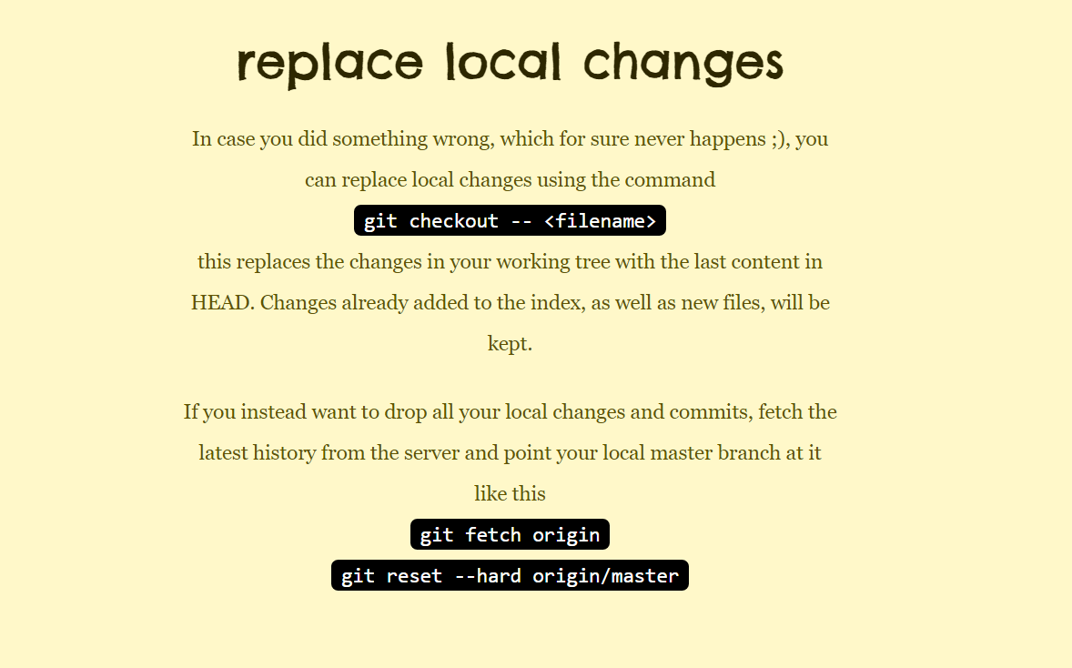
The simple guide (12)
12e-BM/KD/HDCV/FSOFT v1/1

Slide 17
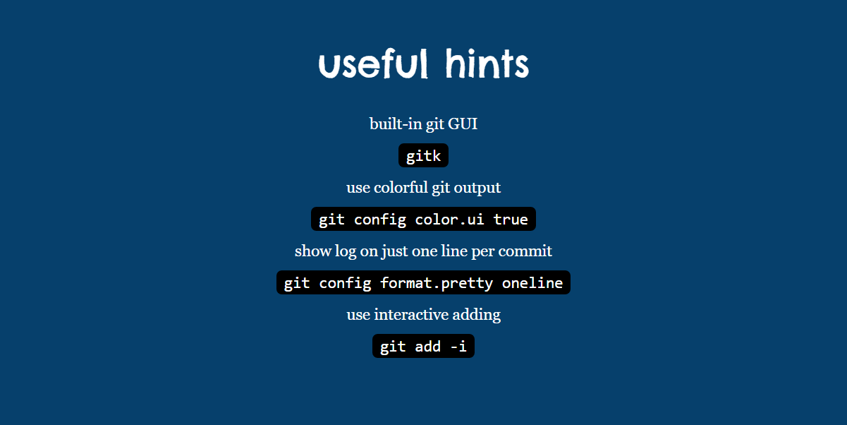
The simple guide (13)
12e-BM/KD/HDCV/FSOFT v1/1

Slide 18
The simple guide (14)
guides
Git Community Book
Pro Git
Think like a git
GitHub Help
A Visual Git Guide
get help
Git User Mailing List
#git on irc.freenode.net
12e-BM/KD/HDCV/FSOFT v1/1

Slide 19
Free Talk
12e-BM/KD/HDCV/FSOFT v1/1

Slide 20
THANK YOU!
12e-BM/KD/HDCV/FSOFT v1/1

